Slide 1
5. Conditioning and Independence

Slide 2
Conditional PMF
Let X be a random variable and A be an event.
The conditional PMF of X given A is
P(X = x and A)
P(X = x | A) =
P(A)

Slide 3
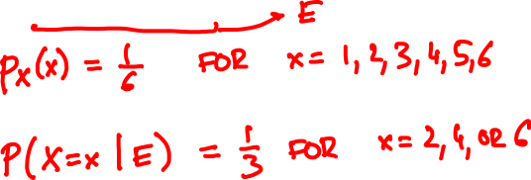
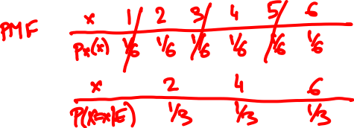
What is the PMF of a 6-sided die roll given that the outcome is even?

Slide 4
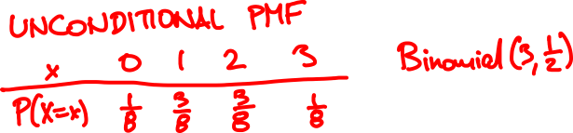
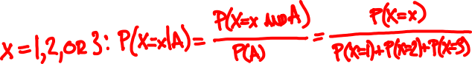
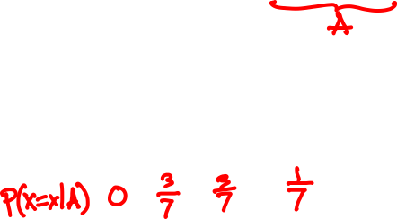
You flip 3 coins. What is the PMF number of heads given that there is at least one?

Slide 5
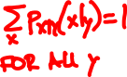
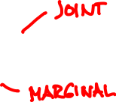
Conditioning on a random variable
Let X and Y be random variables.
The conditional PMF of X given Y is
P(X = x and Y = y)
P(X = x | Y = y ) =
P(Y = y )
p_{XY}(x, y)
p_{X|Y}(x | y) =
p_{Y}(y)
For fixed y, p_{X|Y} is a PMF as a function of x.

Slide 6
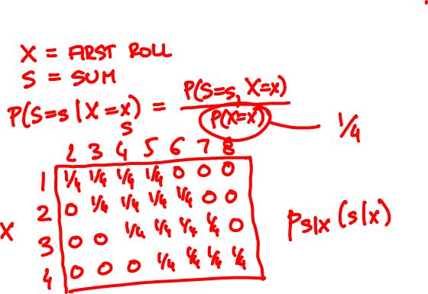
Roll two 4-sided dice. What is the PMF of the sum given the first roll?

Slide 7
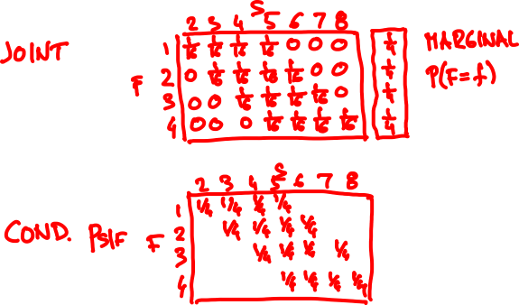
Roll two 4-sided dice. What is the PMF of the sum given the first roll?

Slide 8
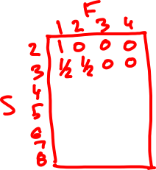
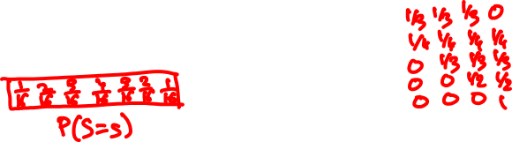
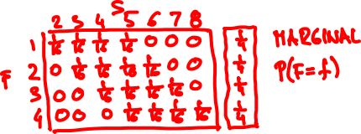
Roll two 4-sided dice. What is the PMF of the first roll given the sum?

Slide 9
Conditional Expectation
The conditional expectation of X given event A is
E[X | A] = ∑_{x} x P(X = x | A)
The conditional expectation of X given Y = y is
E[X | Y = y] = ∑_{x} x P(X = x | Y = y)

Slide 10
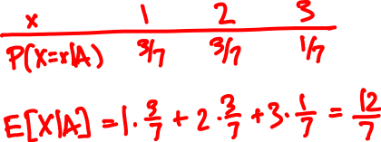
You flip 3 coins. What is the expected number of heads given that there is at least one?

Slide 11
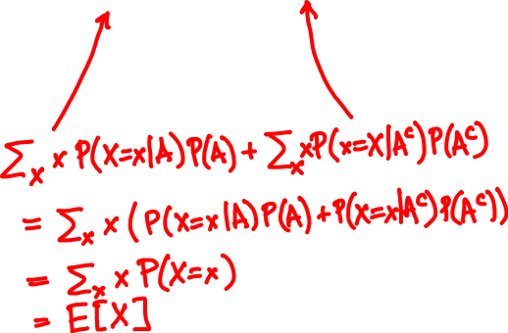
Total Expectation Theorem
E[X] = E[X|A] P(A) + E[X|A^{c}] P(A^{c})
Proof

Slide 12
Total Expectation Theorem (general form)
If A₁,…, A_{n} partition Ω then
A₁
A₃
A₄
A₅
A₂
E[X] = E[X|A₁]P(A₁) + … + E[X|A_{n}]P(A_{n})
In particular
Σ
E[X] = _{y} E[X|Y = y] P(Y = y)

Slide 13
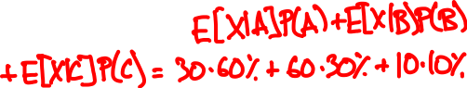
👩‍🏫 👵 🕵️‍♂️
type
average time
on facebook
30 min
60 min
10 min
% of visitors
60%
30%
10%
average visitor time =

Slide 14
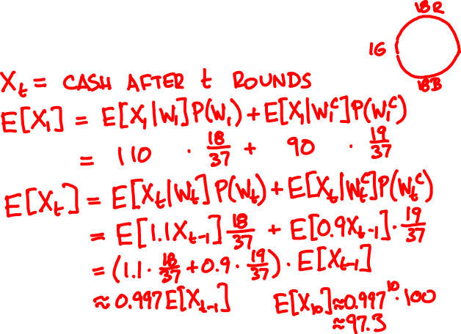
You play 10 rounds of roulette. You start with $100 and bet 10% on red in every round.
On average, how much cash will remain?

Slide 15
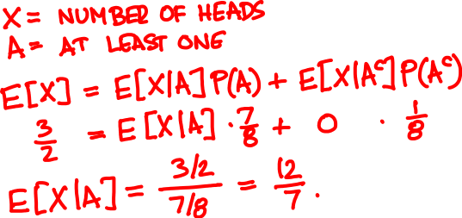
You flip 3 coins. What is the expected number of heads given that there is at least one?

Slide 16
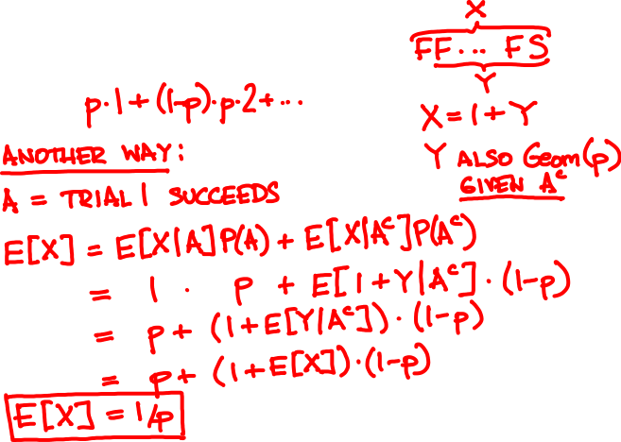
Mean of the Geometric
X = Geometric(p) random variable
E[X] =

Slide 17
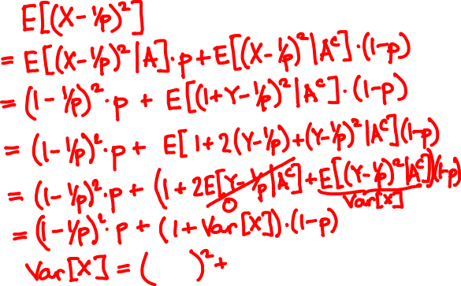

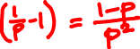
Variance of the Geometric
X = Geometric(p) random variable
Var[X] =

Slide 18
Geometric(0.5)
Geometric(0.7)
Geometric(0.05)

Slide 19
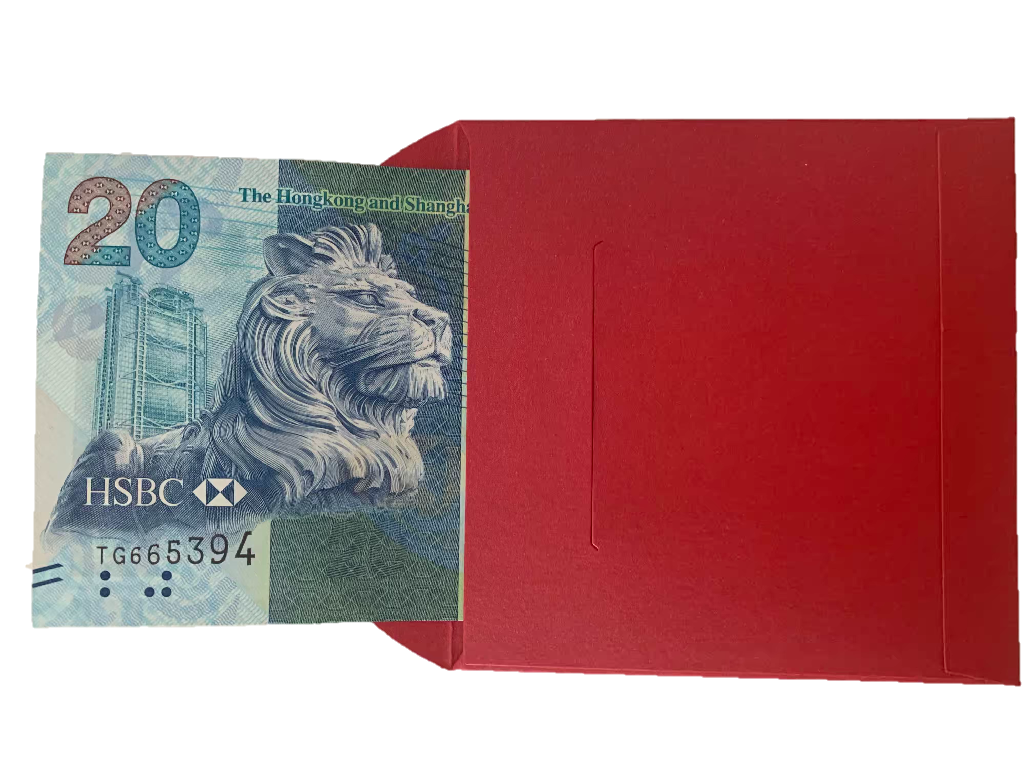
$x
👩‍💼
$2x
🧧
🧧
stay or switch?
👦

Slide 20

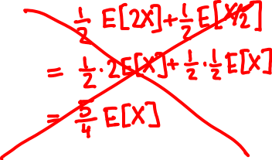
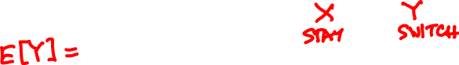
Bob should stay because…
Bob should switch because…

Slide 21
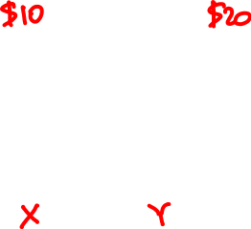
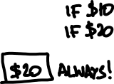
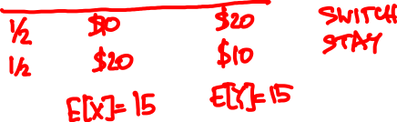
👩‍💼
🧧
🧧

Slide 22
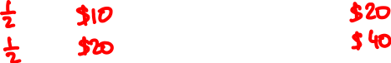
👩‍💼
🧧
🧧

Slide 23
Independent random variables
Let X and Y be discrete random variables.
X and Y are independent if
P(X = x, Y = y) = P(X = x) P(Y = y)
for all possible values of x and y.
In PMF notation, p_{XY}(x, y) = p_{X}(x) p_{Y}(y) for all x, y.

Slide 24
Independent random variables
X and Y are independent if
P(X = x | Y = y) = P(X = x)
for all x and y such that P(Y = y) > 0.
In PMF notation, p_{X|Y}(x | y) = p_{X}(x) if p_{Y}(y) > 0.

Slide 25
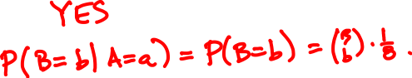
Alice tosses 3 coins and so does Bob. Alice gets $1 per head and Bob gets $1 per tail.
Are their earnings independent?

Slide 26
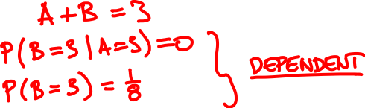
Now they toss the same coin 3 times. Are their earnings independent?

Slide 27
Expectation and independence
X and Y are independent if and only if
E[f(X)g(Y)] = E[f(X)] E[g(Y)]
for all real valued functions f and g.

Slide 28
Expectation and independence
In particular, if X and Y are independent then
E[XY] = E[X] E[Y]
Not true in general!

Slide 29
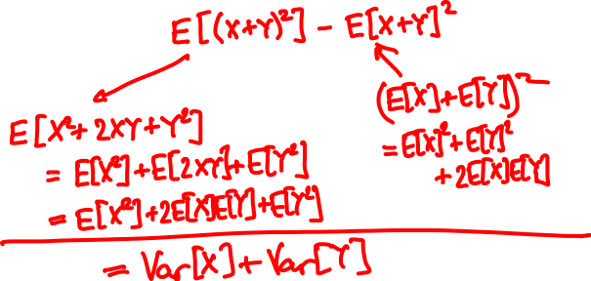
Variance of a sum
Recall Var[X] = E[(X – E[X])²] = E[X²] – E[X]²
Var[X + Y] =

Slide 30
Variance of a sum
Var[X₁ + … + X_{n}] = Var[X₁] + … + Var[X_{n}]
if every pair X_{i}, X_{j} is independent.
Not true in general!

Slide 31
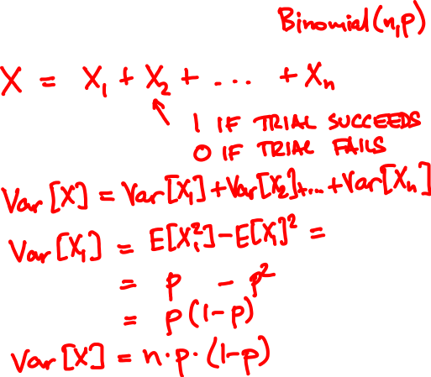
Variance of the Binomial

Slide 32
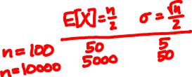
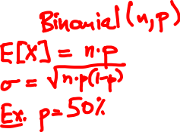
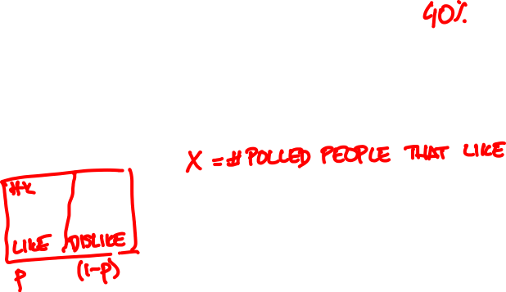
Sample mean
👩🏻‍🦳👩🏻‍🎤👵🤰🏽🧔🏼👧🏻👨🏻‍🏫🧕👨‍✈️👨🏾‍🎨
👍👍👎👍👎👎👎👎👍👎

Slide 33
n = 1
n = 10
p = 0.35
n = 100
n = 1000

Slide 34
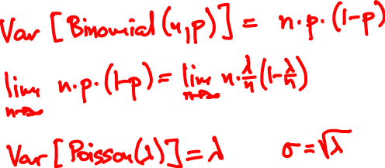
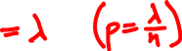
Variance of the Poisson
Poisson(λ) approximates Binomial(n, λ/n) for large n
p(k) = e^{-λ} λ^{k}/k!
k = 0, 1, 2, 3, …

Slide 35
Independence of multiple random variables
X, Y, Z independent if
P(X = x, Y = y, Z = z) = P(X = x) P(Y = y) P(Z = z)
for all possible values of x, y, z.
X, Y, Z independent if and only if
E[f(X)g(Y)h(Z)] = E[f(X)] E[g(Y)] E[h(Z)]
for all f, g, h.
Usual warnings apply.

